Slide 1

Chapter 7
Introduction to Cassandra
Big Data and Analytics by Seema Acharya and Subhashini Chellappan
Copyright 2015, WILEY INDIA PVT. LTD.

Slide 2
Agenda
◆ Apache Cassandra – An Introduction
◆ Features of Cassandra
Peer-to-Peer Network
Writes in Cassandra
Hinted Handoffs
Tunable Consistency: Read Consistency and Write Consistency
◆ CQL Data Types
◆ CQLSH
◆ CRUD : Insert, Update, Delete and Select
◆ Collections : Set, List and Map
◆ Time To Live (TTL)
◆ Import and Export
Big Data and Analytics by Seema Acharya and Subhashini Chellappan
Copyright 2015, WILEY INDIA PVT. LTD.

Slide 3
Apache Cassandra – An Introduction
Big Data and Analytics by Seema Acharya and Subhashini Chellappan
Copyright 2015, WILEY INDIA PVT. LTD.

Slide 4
Apache Cassandra – An Introduction
◆ Apache Cassandra was born at Facebook. After Facebook open sourced the code in 2008, Cassandra became an Apache Incubator project in 2009 and subsequently became a top-level Apache project in 2010.
◆ It is a column-oriented database designed to support peer-to-peer symmetric nodes instead of the master−slave architecture.
◆ It is built on Amazon’s dynamo and Google’s Big Table.
Cassandra does not compromise on availability. Since it does not have master slave architecture. (No Single point of Failures)
Big Data and Analytics by Seema Acharya and Subhashini Chellappan
Copyright 2015, WILEY INDIA PVT. LTD.

Slide 5
Features of Cassandra
Big Data and Analytics by Seema Acharya and Subhashini Chellappan
Copyright 2015, WILEY INDIA PVT. LTD.

Slide 6
Features of Cassandra
Open Source
Distributed
Decentralized (Server Symmetry)
No single point of failure
Column-oriented
Peer to Peer
Elastic Scalability
Big Data and Analytics by Seema Acharya and Subhashini Chellappan
Copyright 2015, WILEY INDIA PVT. LTD.

Slide 7

Companies successfully deployed Cassandra
Netflix
online DVD and Blu-Ray movie retailer
Nielsen study showed that 38% of Americans use or subscribe to Netflix
Why Cassandra?
Using a central SQL database negatively impacted scalability and availability
International Expansion required Multi-Datacenter solution
Need for configurable Replication, Consistency, and Resiliency in the face of failure
Cassandra on AWS offered high levels of scalability and availability

Slide 8

Companies successfully deployed Cassandra
Spotify
Streaming digital music service
Music for every moment on computer, phone, tablet, and more
Why Cassandra?
With more users, scalability problems arised using postgreSQL
With multiple data centers, streaming replication in postgreSQL was problematic
ex: high write volumes
Chose Cassandra
lack of single points of failure
no data loss confidence
Big Table design

Slide 9

Companies successfully deployed Cassandra
Hulu
a website and a subscription service offering on-demand streaming video media
~30 million unique viewers per month
Why Cassandra?
need for Availability
need for Scalability
Good Performance
Nearly Linear Scalability
Geo-Replication
Minimal Maintenance Requirements

Slide 10
Companies successfully deployed Cassandra
Twitter
Cisco
Adobe
Ebay
Rack space
https://cassandra.apache.org/_/case-studies.html

Slide 11
Cassandra Architecture
Big Data and Analytics by Seema Acharya and Subhashini Chellappan
Copyright 2015, WILEY INDIA PVT. LTD.

Slide 12
Cassandra Architecture
Peer –to-Peer Architecture
Gossip and Failure Detection
Partitioner
Replication Factor
Anti- Entropy and Read repair
Writes in Cassandra
Hinted Handoffs
Tunable Consistency

Slide 13
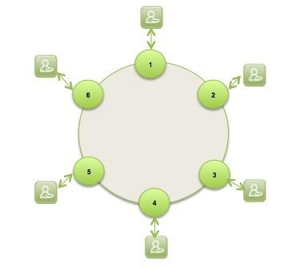
Peer to Peer Network
Cassandra is designed to distribute and manage large data loads across multiple nodes in a cluster.
Does not have Master Slave architecture( no SOP)
A node in Cassandra is structurally identical to nay other node.
In case any node fails, it definitely impacts the throughput.
However incase of graceful degradation where everything does not come crashing at any given instant owing to node failure

Slide 14
Gossip Protocol and Failure Detection
Gossip protocol is used for intra ring communication.
It is a peer to peer communication protocol which eases discovery and sharing of location and state information with other nodes in cluster.
Network Communication protocols inspired for real life rumor spreading.
Example – Node A wish to search for pattern in data
Round 1 – Node A searches locally and then gossips with node B.
Round 2 – Node A,B gossips with C and D.
Round 3 – Nodes A,B,C and D gossips with 4 other nodes ……
Round by round doubling makes protocol very robust.

Slide 15
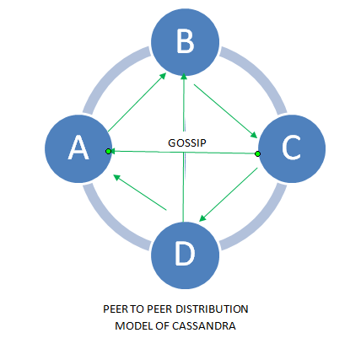
Gossip Protocol

Slide 16
Failure Detection- Anti-Entropy and Read Repair
For repairing unread data, Cassandra uses what’s called an anti-entropy version of the gossip protocol.
Anti-entropy and Read Repair
A cluster is made of several nodes.
To achieve fault tolerance, a given piece of data is replicated on one or more nodes.
A client can connect to any node in the cluster to read data.
AntiEntropy means comparing all the replicas of each piece of data that exist (or are supposed to) and updating each replica to the newest version.
Some times few nodes may respond with out –of date value . This can be repaired using Read Repair operation.
Read repair operation is performed either before or after returning the value to the client as per the specified consistency level.

Slide 17
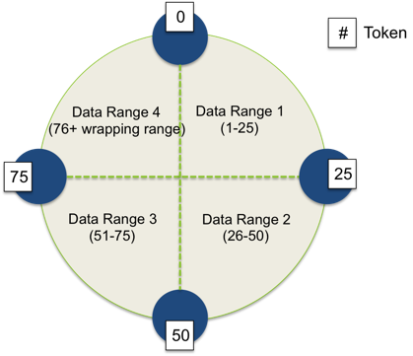
Partitioner
A partitioner takes a call on how to distribute data on the various nodes in cluster. Nodes are logically structured in Ring Topology.
It also determines a node on which to place the very first copy of the data.
Basically a partitioner is a hash function to compute the token of the partition key.

Slide 18
Replication
Replication Factor(RF) determines the number of copies of data.
RF should ideally be more than one and not more than the number of nodes in the cluster.
Two replication strategies are,
Simple strategy
Network Topology strategy

Slide 19
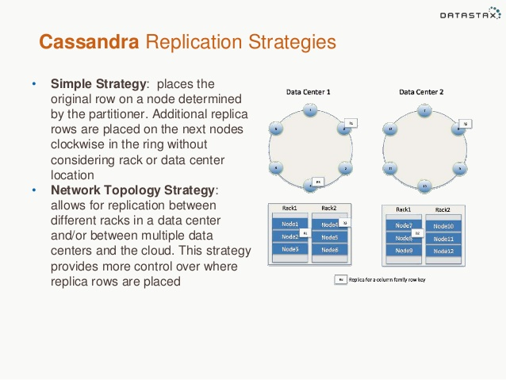
Two different Replication strategies

Slide 20
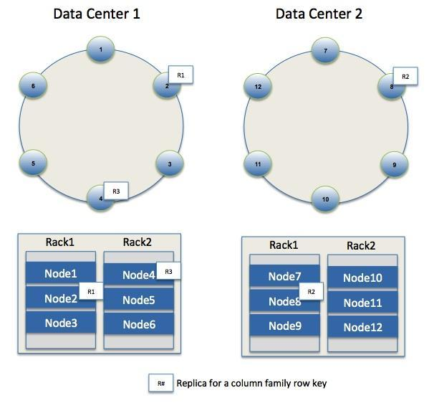
Replication
Different Replication Policies
Rack Unaware – replicate data at N-1 successive nodes after its coordinator
Rack Aware – uses ‘Zookeeper’ to choose a leader which tells nodes the range they are replicas for
Datacenter Aware – similar to Rack Aware but leader is chosen at Datacenter level instead of Rack level.

Slide 21
Writes in Cassandra
A client that initiates a write request.
It is first written to the commit log. A write is taken as successful only
if it is written to the commit log.
The next step is to push the write to a memory resident data structure called Memtable. A threshold value is defined in the Memtable.
When the number of objects stored in the Memtable reaches a threshold, the contents of Memtable are flushed to the disk in a file called SSTable (Stored string Table). Flushing is a non-blocking operation.
It is possible to have multiple Memtables for a single column family.
One out of them is current and the rest are waiting to be flushed.
Big Data and Analytics by Seema Acharya and Subhashini Chellappan
Copyright 2015, WILEY INDIA PVT. LTD.

Slide 22
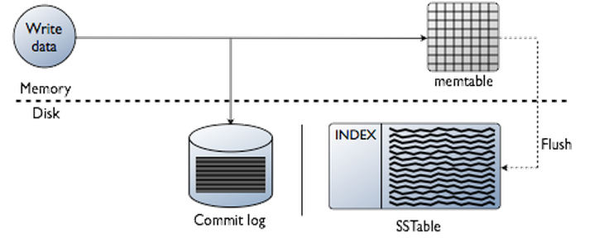
Writes in Cassandra

Slide 23
Read Operation
Client
Query
Result
Cassandra Cluster
Read repair if digests differ
Closest replica
Result
Replica A
Digest Query
Digest Response
Digest Response
Replica B
Replica C
* Figure taken from Avinash Lakshman and Prashant Malik (authors of the paper) slides.

Slide 24




Hinted Handoffs
Coordinator
Node C is down.
Write a hint in your table
A
Writes Row K
Client
System hints table
Replicates Row K
B
Hint will have the following data:
Location of the node on which the replica is to be placed
Version meta data
The Actual data
C
Big Data and Analytics by Seema Acharya and Subhashini Chellappan
Copyright 2015, WILEY INDIA PVT. LTD.

Slide 25
Tunable Consistency
Consistency describes how and whether a system is left in a consistent state after an operation.
In distributed data systems like Cassandra, this usually means that once a writer has written, all readers will see that write.
On the contrary to the strong consistency used in most relational databases (ACID ) Cassandra is at the other end of the spectrum (BASE for Basically Available Soft-state Eventual consistency).
Cassandra weak consistency comes in the form of eventual consistency which means the database eventually reaches a consistent state.
As the data is replicated, the latest version of something is sitting on some node in the cluster, but older versions are still out there on other nodes, but eventually all nodes will see the latest version.
Big Data and Analytics by Seema Acharya and Subhashini Chellappan
Copyright 2015, WILEY INDIA PVT. LTD.

Slide 26
Read Consistency
ONE | Returns a response from the closest node (replica) holding the data.
QUORUM | Returns a result from a quorum of servers with the most recent timestamp for the data.
LOCAL_QUORUM | Returns a result from a quorum of servers with the most recent timestamp for the data in the same data center as the coordinator node.
EACH_QUORUM | Returns a result from a quorum of servers with the most recent timestamp in all data centers.
ALL | This provides the highest level of consistency of all levels and the lowest level of availability of all levels. It responds to a read request from a client after all the replica nodes have responded.
Big Data and Analytics by Seema Acharya and Subhashini Chellappan
Copyright 2015, WILEY INDIA PVT. LTD.

Slide 27
Read Consistency
More specifically:
R=read replica count
W=write replica count
N=replication factor
Q=QUORUM (Q = N / 2 + 1)
If W + R > N, you will have consistency
W=1, R=N
W=N, R=1
W=Q, R=Q where Q = N / 2 + 1
Cassandra provides consistency when R + W > N
A Consistency Level of ONE means R or W is 1.
A Consistency Level of QUORUM means R or W is ceiling((N+1)/2).
A Consistency Level of ALL means R or W is N.
So if you want to write with a Consistency Level of ONE and then get the same data when you read, you need to read with Consistency Level ALL.

Slide 28
Write Consistency
ALL | This is the highest level of consistency of all levels as it necessitates that a write must be written to the commit log and Memtable on all replica nodes in the cluster.
EACH_QUORUM | A write must be written to the commit log and Memtable on a quorum of replica nodes in all data centers.
QUORUM | A write must be written to the commit log and Memtable on a quorum of replica nodes.
LOCAL_QUORUM | A write must be written to the commit log and Memtable on a quorum of replica nodes in the same data center as the coordinator node. This is to avoid latency of inter-data center communication.
ONE | A write must be written to the commit log and Memtable of at least one replica node.
TWO | A write must be written to the commit log and Memtable of at least two replica nodes.
THREE | A write must be written to the commit log and Memtable of at least three replica nodes.
LOCAL_ONE | A write must be sent to, and successfully acknowledged by, at least one replica node in the local data center.
Big Data and Analytics by Seema Acharya and Subhashini Chellappan
Copyright 2015, WILEY INDIA PVT. LTD.

Slide 29
Data Model
keyspace
settings
column family
settings
column
name
value
timestamp

Slide 30
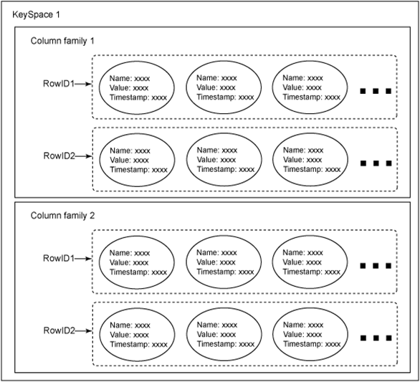
Cassandra data model
Cassandra is a column oriented NoSQL system
Column families: sets of key-value pairs
column family as a table and key-value pairs as a row (using relational database analogy)
A row is a collection of columns labeled with a name

Slide 31
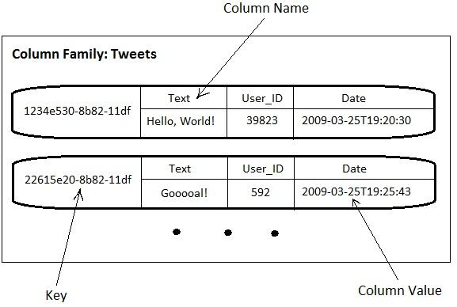
Cassandra Row
the value of a row is itself a sequence of key-value pairs
such nested key-value pairs are columns
key = column name
a row must contain at least 1 column.

Slide 32
Key Space
A Key Space is a group of column families together.
It is only a logical grouping of column families and provides an isolated scope for names

Slide 33
Facebook Inbox Search
Cassandra developed to address this problem.
50+TB of user messages data in 150 node cluster on which Cassandra is tested.
Search user index of all messages in 2 ways.
Term search : search by a key word
Interactions search : search by a user id
Latency Stat | Search Interactions | Term Search
Min | 7.69 ms | 7.78 ms
Median | 15.69 ms | 18.27 ms
Max | 26.13 ms | 44.41 ms

Slide 34
Comparison with MySQL
MySQL > 50 GB Data Writes Average : ~300 ms Reads Average : ~350 ms
Cassandra > 50 GB Data Writes Average : 0.12 ms Reads Average : 15 ms
Stats provided by Authors using facebook data.

Slide 35
Cassandra Query Language Data types
Big Data and Analytics by Seema Acharya and Subhashini Chellappan
Copyright 2015, WILEY INDIA PVT. LTD.

Slide 36
CQL Data types
Int | 32 bit signed integer
Bigint | 64 bit signed long
Double | 64-bit IEEE-754 floating point
Float | 32-bit IEEE-754 floating point
Boolean | True or false
Blob | Arbitrary bytes, expressed in hexadecimal
Counter | Distributed counter value
Decimal | Variable – precision integer
List | A collection of one or more ordered elements
Map | A JSON style array of elements
Set | A collection of one or more elements
Timestamp | Date plus time
Varchar | UTF 8 encoded string
Varint | Arbitrary-precision integers
Text | UTF 8 encoded string
Big Data and Analytics by Seema Acharya and Subhashini Chellappan
Copyright 2015, WILEY INDIA PVT. LTD.

Slide 37
CQLSH
Big Data and Analytics by Seema Acharya and Subhashini Chellappan
Copyright 2015, WILEY INDIA PVT. LTD.

Slide 38
CRUD - Keyspace
To create a keyspace by the name “Students”
CREATE KEYSPACE Students WITH REPLICATION = {
'class':'SimpleStrategy', 'replication_factor':1
};
Big Data and Analytics by Seema Acharya and Subhashini Chellappan
Copyright 2015, WILEY INDIA PVT. LTD.

Slide 39
To Describe existing key spaces
DESCRIBE KEYSPACES;
To get more details about key space like Keyspace name, durable writes, strategy class, etc.
SELECT * FROM system.schema_keyspaces;
To use keyspace
> USE KEYSPACE NAME

Slide 40
CRUD – Create Table
To create a column family or table by the name “student_info”.
CREATE TABLE Student_Info ( RollNo int PRIMARY KEY, StudName text, DateofJoining timestamp, LastExamPercent double
);
Big Data and Analytics by Seema Acharya and Subhashini Chellappan
Copyright 2015, WILEY INDIA PVT. LTD.

Slide 41
CRUD - Insert
Insert writes one or more columns to a record in Cassandra table automatically.
Insert statement does not return output.
Primary key is must.
To insert data into the column family “student_info”.
BEGIN BATCH
INSERT INTO student_info (RollNo,StudName,DateofJoining,LastExamPercent) VALUES (1,'Michael Storm','2012-03-29', 69.6)
INSERT INTO student_info (RollNo,StudName,DateofJoining,LastExamPercent) VALUES (2,'Stephen Fox','2013-02-27', 72.5)
APPLY BATCH;
Big Data and Analytics by Seema Acharya and Subhashini Chellappan
Copyright 2015, WILEY INDIA PVT. LTD.

Slide 42
CRUD - Select
To view the data from the table “student_info”.
SELECT *
FROM student_info;
To view only those record where the roll no column either has a value 1 or 2 or 3
SELECT *FROM student_info WHERE RollNO IN (1,2,3)
Big Data and Analytics by Seema Acharya and Subhashini Chellappan
Copyright 2015, WILEY INDIA PVT. LTD.

Slide 43
CRUD – Create Index
To create an index on the “studname” column of the “student_info”
column family use the following statement
CREATE INDEX ON student_info(studname);
To execute the query using Index
SELECT * FROM student_info WHERE studname=‘Stephen Fox’;
To Create another index on column LastExamPercent
CREATE INDEX ON student_info(LastExamPercent);
Big Data and Analytics by Seema Acharya and Subhashini Chellappan
Copyright 2015, WILEY INDIA PVT. LTD.

Slide 44
Other opertaors
Limit
AS (alias)
Order By
Group By
Desc
ASC ( the default sorting order)
SELECT rollno, hobbies, language, lastexampercent FROM student_info LIMIT 2;
SELECT rollno, language AS “known language” FROM student_info;

Slide 45
CRUD – Update
To update the value held in the “StudName” column of the “student_info” column family to “David Sheen” for the record where the RollNo column has value = 2.
Note: An update updates one or more column values for a given row to the Cassandra table. It does not return anything.
UPDATE student_info SET StudName = 'David Sheen' WHERE RollNo = 2;
Big Data and Analytics by Seema Acharya and Subhashini Chellappan
Copyright 2015, WILEY INDIA PVT. LTD.

Slide 46
Update Primary Key
UPDATE student_info SET rollno=6 WHERE rollNo = 2;
But it returns Bad request . It does not allow to update primary key column.

Slide 47
Updating more than one column of a row
1. Before update
Select rollno, studname,lastexam percent from student_info where rollno=3;
2. Applying update
UPDATE student_info SET lastexampercent = 85 WHERE rollNo = 3;
Another Example:
UPDATE Movies SET col1 = val1, col2 = val2 WHERE movieID = key1;

Slide 48
Update a column in several rows at once:
UPDATE users SET state = 'TX' WHERE user_uuid IN (88b8fd18-b1ed-4e96-bf79-4280797cba80, 06a8913c-c0d6-477c-937d-6c1b69a95d43, bc108776-7cb5-477f-917d-869c12dfffa8)

Slide 49
CRUD – Delete
To delete the column “LastExamPercent” from the “student_info” table for the record where the RollNo = 2.
Note: Delete statement removes one or more columns from one or more
rows of a Cassandra table or removes entire rows if no columns are specified.
DELETE LastExamPercent FROM student_info WHERE RollNo=2;
Big Data and Analytics by Seema Acharya and Subhashini Chellappan
Copyright 2015, WILEY INDIA PVT. LTD.

Slide 50
Delete Row from table
DELETE FROM student_info WHERE rollno=2;

Slide 51
Why ALLOW FILTERING?
Let’s take for example the following table:
CREATE TABLE blogs (blogId int,
time1 int,
time2 int,
author text,
content text,
PRIMARY KEY(blogId, time1, time2));
To execute the following query:
SELECT * FROM blogs;

Slide 52
Why ALLOW FILTERING?
If you now want only the data at a specified time1
SELECT * FROM blogs WHERE time1 = 1418306451235;
In response, you will receive the following error message:
Bad Request: Cannot execute this query as it might involve data filtering and thus may have unpredictable performance. If you want to execute this query despite the performance unpredictability, use ALLOW FILTERING.

Slide 53
Why ALLOW FILTERING?
Cassandra knows that it might not be able to execute the query in an efficient way.
It is therefore warning you: “Be careful. Executing this query as such might not be a good idea
as it can use a lot of your computing resources”.
The only way Cassandra can execute this query is by retrieving all the rows from the table blogs and then by filtering out the ones which do not have the requested value for the time1 column.
SELECT * FROM blogs WHERE time1 = 1418306451235 ALLOW FILTERING;

Slide 54
Collections
Big Data and Analytics by Seema Acharya and Subhashini Chellappan
Copyright 2015, WILEY INDIA PVT. LTD.

Slide 55
Collections
When to use collection?
Use collection when it is required to store or denormalize a small amount of data.
What is the limit on the values of items in a collection?
The values of items in a collection are limited to 64K.
Where to use collections?
Collections can be used when you need to store the following:
Phone numbers of users.
Email ids of users.
Big Data and Analytics by Seema Acharya and Subhashini Chellappan
Copyright 2015, WILEY INDIA PVT. LTD.

Slide 56
Different Collections
SET collection
A column of type set consists of unordered unique values.
LIST collection
When the order of elements is required we can use list. List allows to store the same values multiple times.
MAP collection
Map is used to map one thing to another. A map is a pair of typed values.
Each element of the map is stored as a Cassandra column.

Slide 57
Collections - Set
To alter the schema for the table “student_info” to add a column “hobbies”.
ALTER TABLE student_info ADD hobbies set<text>;
Big Data and Analytics by Seema Acharya and Subhashini Chellappan
Copyright 2015, WILEY INDIA PVT. LTD.

Slide 58
Collections - Set
To update the table “student_info” to provide the values for “hobbies” for the student with Rollno =1.
UPDATE student_info
SET hobbies = hobbies + {'Chess, Table Tennis'} WHERE RollNo=1;
Big Data and Analytics by Seema Acharya and Subhashini Chellappan
Copyright 2015, WILEY INDIA PVT. LTD.

Slide 59
Collections - List
To alter the schema of the table “student_info” to add a list column “language”.
ALTER TABLE student_info ADD language list<text>;
Big Data and Analytics by Seema Acharya and Subhashini Chellappan
Copyright 2015, WILEY INDIA PVT. LTD.

Slide 60
Collections - List
To update values in the list column, “language” of the table “student_info”.
UPDATE student_info
SET language = language + ['Hindi, English'] WHERE RollNo=1;
DELETE language[1] FROM student_info WHERE rollno=1;
Big Data and Analytics by Seema Acharya and Subhashini Chellappan
Copyright 2015, WILEY INDIA PVT. LTD.

Slide 61
Collections - Map
To alter the “users” table to add a map column “todo”.
ALTER TABLE users
ADD todo map<timestamp, text>;
Big Data and Analytics by Seema Acharya and Subhashini Chellappan
Copyright 2015, WILEY INDIA PVT. LTD.

Slide 62
Collections - Map
To update the record for user (user_id = ‘AB’) in the “users” table.
UPDATE users
SET todo =
{ ‘2014-9-24’: ‘Cassandra Session’, ‘2014-10-2 12:00’ : ‘MongoDB Session’ }
WHERE user_id = ‘AB’;
Big Data and Analytics by Seema Acharya and Subhashini Chellappan
Copyright 2015, WILEY INDIA PVT. LTD.

Slide 63
More Practice on Collections
1. TO create a table “ users” with an “emails” column. Email column type as SET.
2. To insert values into the “ emails” column of the “ users” table.
3. Add an element to a set using the UPDATE command and the addition (+) operator.
4. To remove an element from a set using the subtraction (-) operator.
UPDATE users SET emails= emails-{XX@gmail.com} WHERE user_id=‘XX’;
5. To alter the users table to add a column, “top places of type list.
Note:
To append use + operator.

Slide 64
COUNTER
A counter is a special column that is changed in increments.
For example we may need a counter column to count the number of times a particular book is issued from the library by the student.
Step1:
CREATE TABLE library_book ( Counter_ value counter,
Book_Name varchar,
stud_name varchar,
PRIMARY KEY(Book_Name, stud_name)
);

Slide 65
COUNTER
Step2:
UPDATE library_book SET counter_value=counter_value+1
WHERE Book_Name=‘Business Analytics’ AND stud_name=‘jeet’;
Step 3: Increase the value of counter
UPDATE library_book SET counter_value=counter_value+1
WHERE Book_Name=‘Business Analytics’ AND stud_name=‘shann’;
Step 4:
UPDATE library_book SET counter_value=counter_value+1
WHERE Book_Name=‘Business Analytics’ AND stud_name=‘jeet’;

Slide 66
Time To Live
Big Data and Analytics by Seema Acharya and Subhashini Chellappan
Copyright 2015, WILEY INDIA PVT. LTD.

Slide 67
Time To Live
Data in a column, other than a counter column, can have an optional expiration period called TTL (time to live). The client request may specify a TTL value for the data. The TTL is specified in seconds.
CREATE TABLE userlogin(
userid int primary key, password text
);
INSERT INTO userlogin (userid, password) VALUES (1,'infy') USING TTL 30; SELECT TTL (password)
FROM userlogin
WHERE userid=1;
Big Data and Analytics by Seema Acharya and Subhashini Chellappan
Copyright 2015, WILEY INDIA PVT. LTD.

Slide 68
ALTER COMMAND
Alter command can be used to change the structure of the table/column.
1. Change the type of the column.
ALTER TABLE sample ALTER sampleid TYPE int;
2. To delete a column.
ALTER TABLE sample DROP sampleid;

Slide 69
DROP command
Drop a table
DROP COLUMNFAMILY Table name ;
Drop a data base
DROP KEYSPACE Keyspace name;

Slide 70
Export to CSV
Big Data and Analytics by Seema Acharya and Subhashini Chellappan
Copyright 2015, WILEY INDIA PVT. LTD.

Slide 71
Export data to a CSV file
Export the contents of the table/column family “elearninglists” present in the “students” database to a CSV file (d:\elearninglists.csv).
COPY elearninglists (id, course_order, course_id, courseowner, title) TO
'd:\elearninglists.csv';
Big Data and Analytics by Seema Acharya and Subhashini Chellappan
Copyright 2015, WILEY INDIA PVT. LTD.

Slide 72
Import from CSV
Big Data and Analytics by Seema Acharya and Subhashini Chellappan
Copyright 2015, WILEY INDIA PVT. LTD.

Slide 73
Import data from a CSV file
To import data from “D:\elearninglists.csv” into the table “elearninglists” present in the “students” database.
COPY elearninglists (id, course_order, course_id, courseowner, title)
FROM 'd:\elearninglists.csv';
Big Data and Analytics by Seema Acharya and Subhashini Chellappan
Copyright 2015, WILEY INDIA PVT. LTD.

Slide 74
COPY persons (id, fname, lname) FROM STDIN;
EXPORT from STDOUT
COPY elearninglists (id, course id, title, owner) TO STDOUT;
IMPORT from STDIN

Slide 75
Querying System Tables
SELECT * FROM system.schema_keyspaces;
SELECT * FROM system.schema_columnfamilies;
SELECT * FROM system.schema_column;

Slide 76
Answer a few quick questions …
Big Data and Analytics by Seema Acharya and Subhashini Chellappan
Copyright 2015, WILEY INDIA PVT. LTD.

Slide 77
Answer Me
◆ What is Cassandra?
◆ Comment on Cassandra writes.
◆ What is your understanding of tunable consistency?
◆ What are collections in CQLSH? Where are they used?
Big Data and Analytics by Seema Acharya and Subhashini Chellappan
Copyright 2015, WILEY INDIA PVT. LTD.

Slide 78
Summary please…
Ask a few participants of the learning program to summarize the lecture.
Big Data and Analytics by Seema Acharya and Subhashini Chellappan
Copyright 2015, WILEY INDIA PVT. LTD.

Slide 79
References …
Big Data and Analytics by Seema Acharya and Subhashini Chellappan
Copyright 2015, WILEY INDIA PVT. LTD.

Slide 80
Further Readings
◆ http://www.datastax.com/documentation/cassandra/2.0/cassandra/gettingS tartedCassandraIntro.html
◆ http://www.datastax.com/documentation/cql/3.1/pdf/cql31.pdf
◆ http://www.datastax.com/documentation/cassandra/2.0/cassandra/dml/dm
l_config_consistency_c.html
Big Data and Analytics by Seema Acharya and Subhashini Chellappan
Copyright 2015, WILEY INDIA PVT. LTD.

Slide 81
Thank you
Big Data and Analytics by Seema Acharya and Subhashini Chellappan
Copyright 2015, WILEY INDIA PVT. LTD.

